Slide 1
sdmay19-31
mpARM
(Multi-Purpose Automated Robotic arM)
http://sdmay19-31.sd.ece.iastate.edu/
Advisor: Prof. Alexander Stoytchev
Client: Brett Altena
Team: Brett Altena, Drew Caneff, Amos Hunter, Kristian Wadolowski, Jase Grant

Slide 2
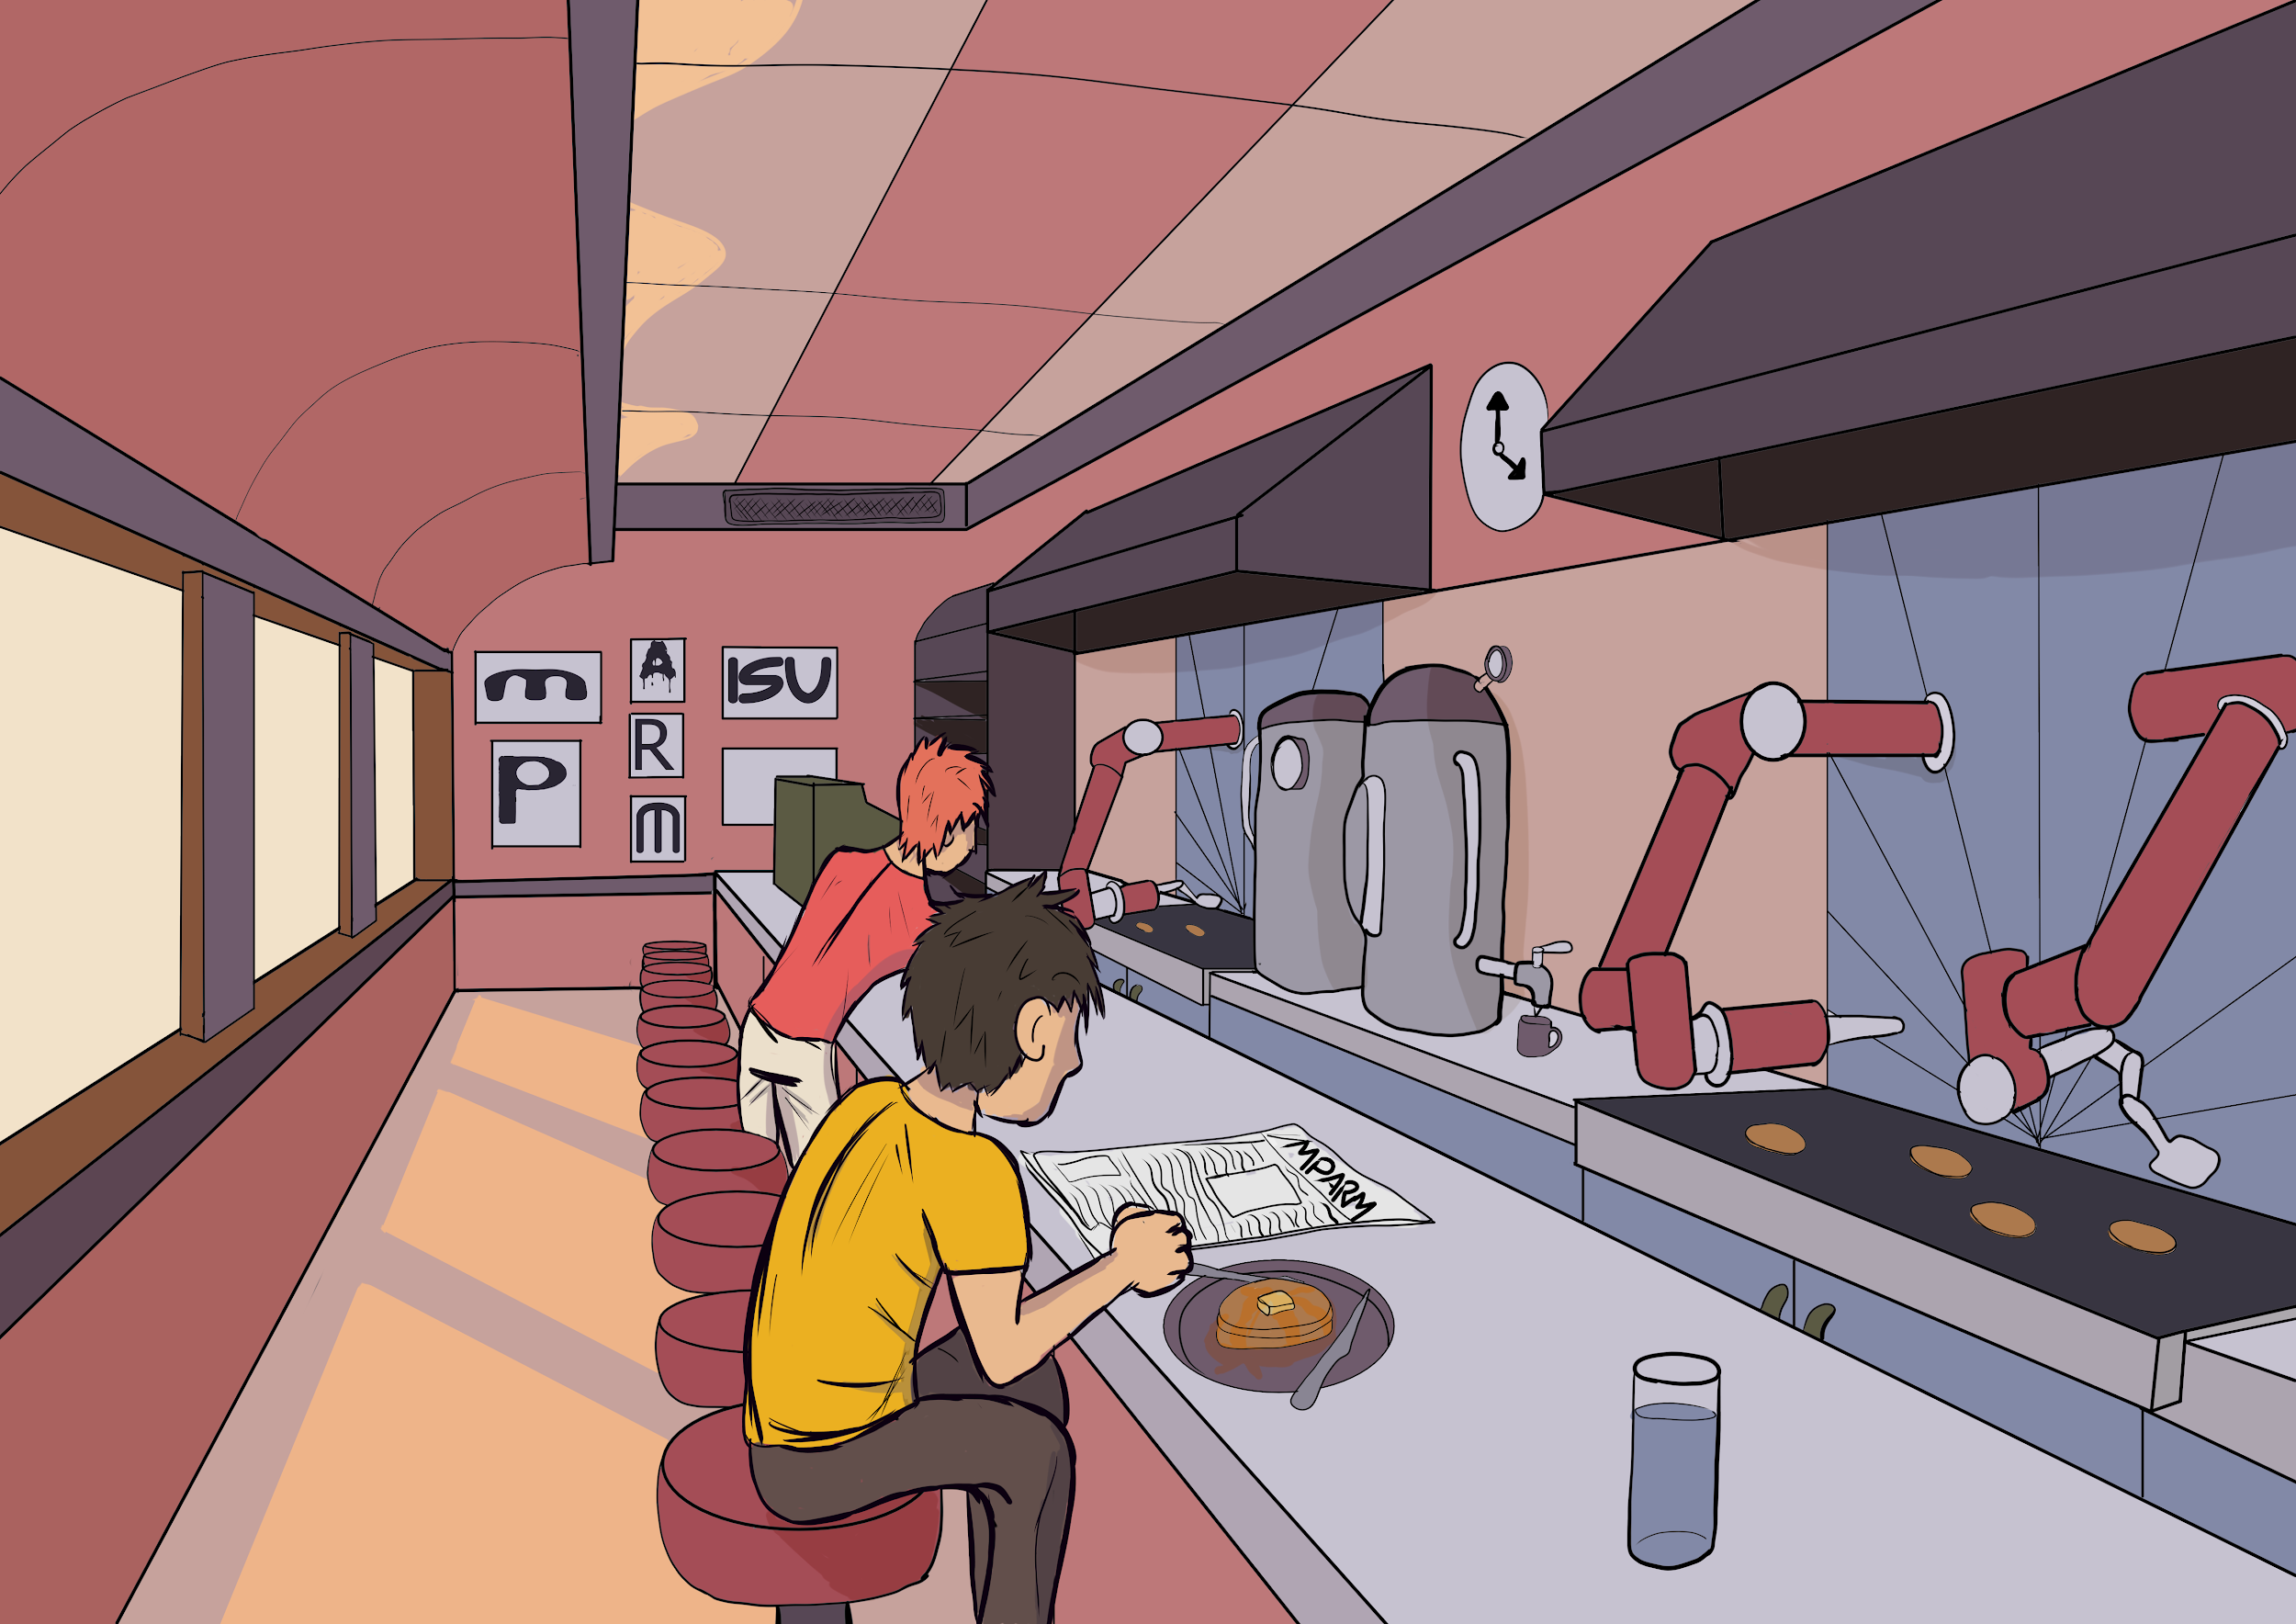
C
O
N
C
E
P
T
S
K
ET
C
H

Slide 3
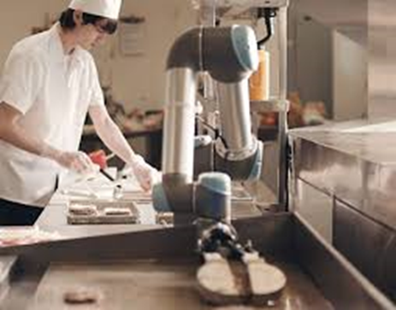
Problem Statement
Problem:
The Food Industry is Experiencing...
Increasing Production Cost of Food
Product Inconsistency
High Food Preparation Times
Kitchen Related Injuries
Solution:
An Automation System That Can…
Function in an Already Existing Kitchen Environment
Work Alongside Humans in the Workplace
Prepare a Variety of Menu Options
Utilize Computer Vision (CV) Coupled With a Robotic Arm For Food Preparation
Goal is to have our system perform the tasks of a human chef at maximum efficiencies
https://www.asme.org/engineering-topics/articles/robotics/robots-kitchen-at-the-table

Slide 4
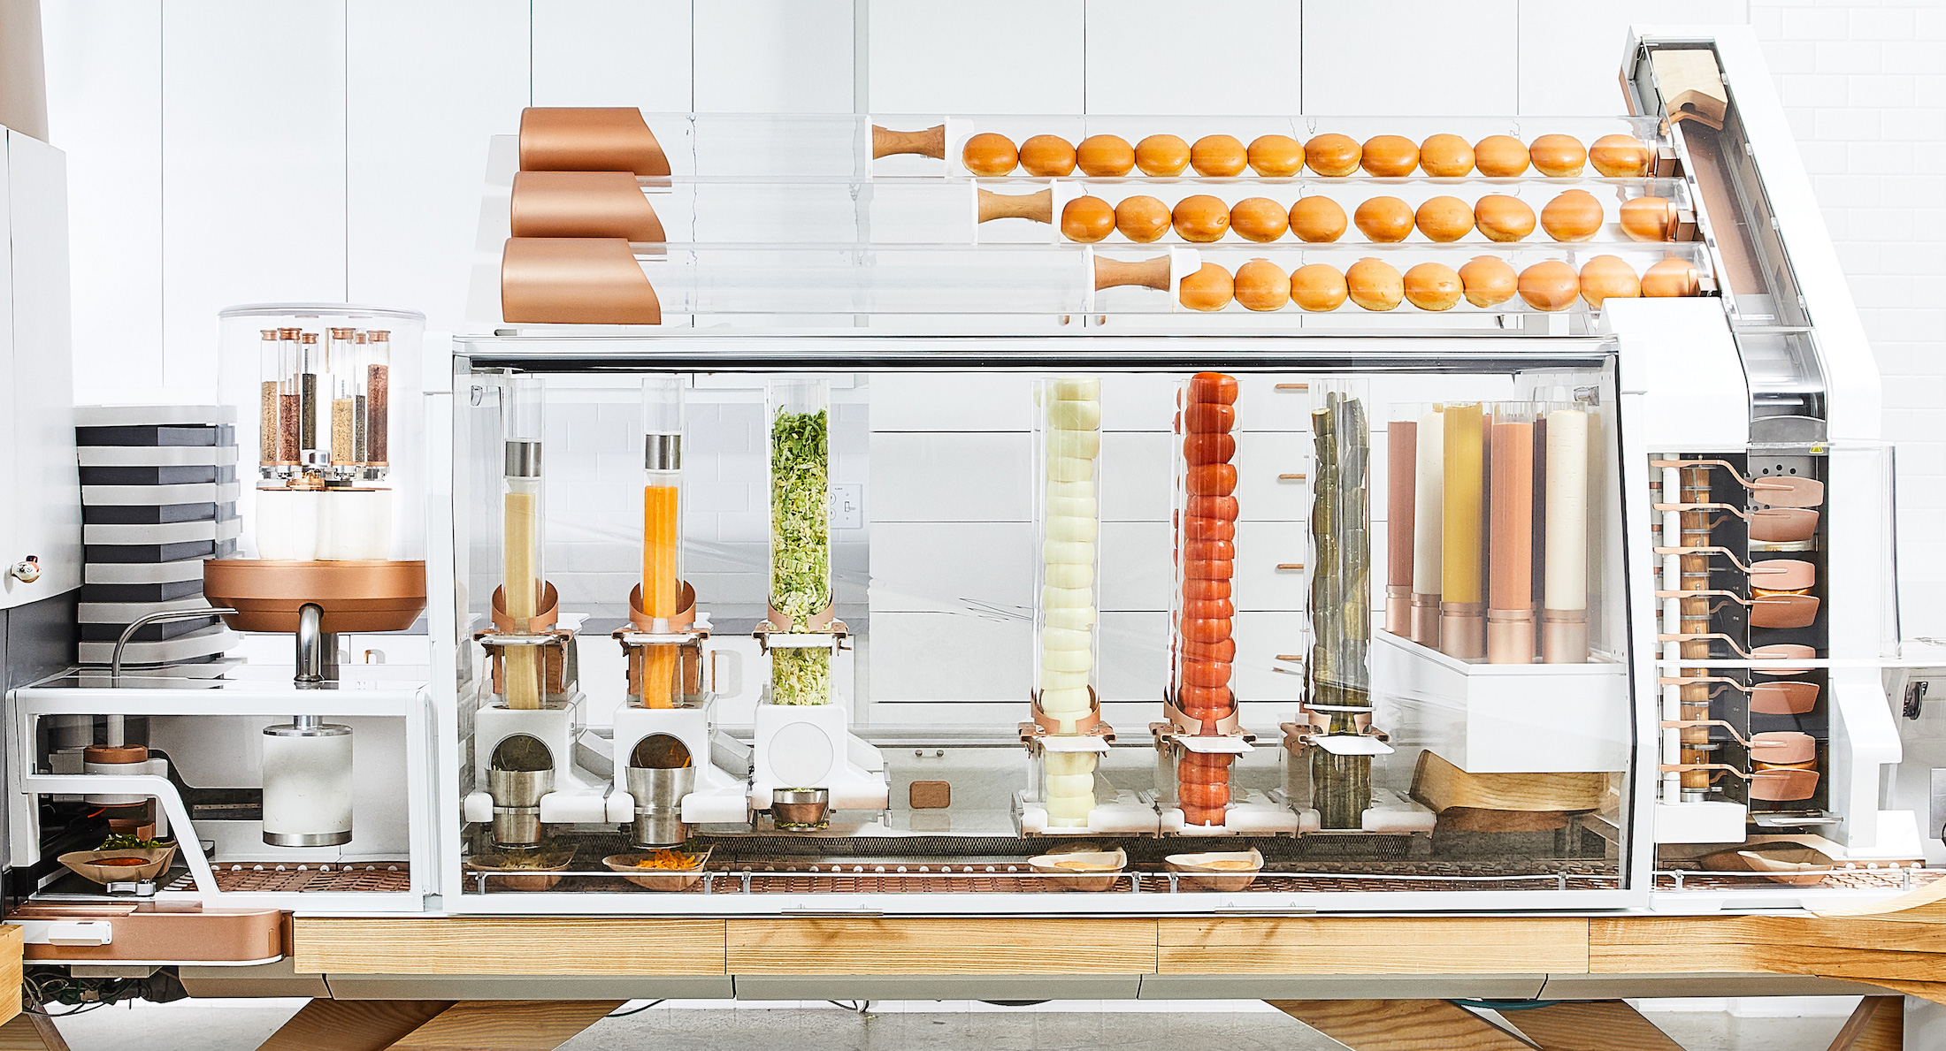
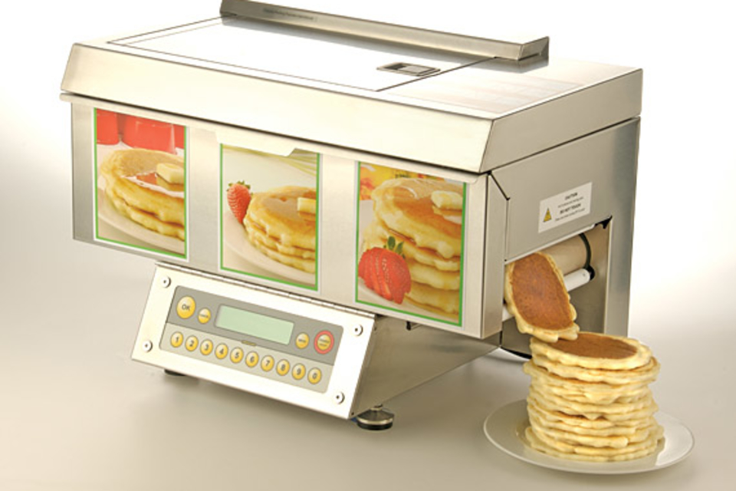
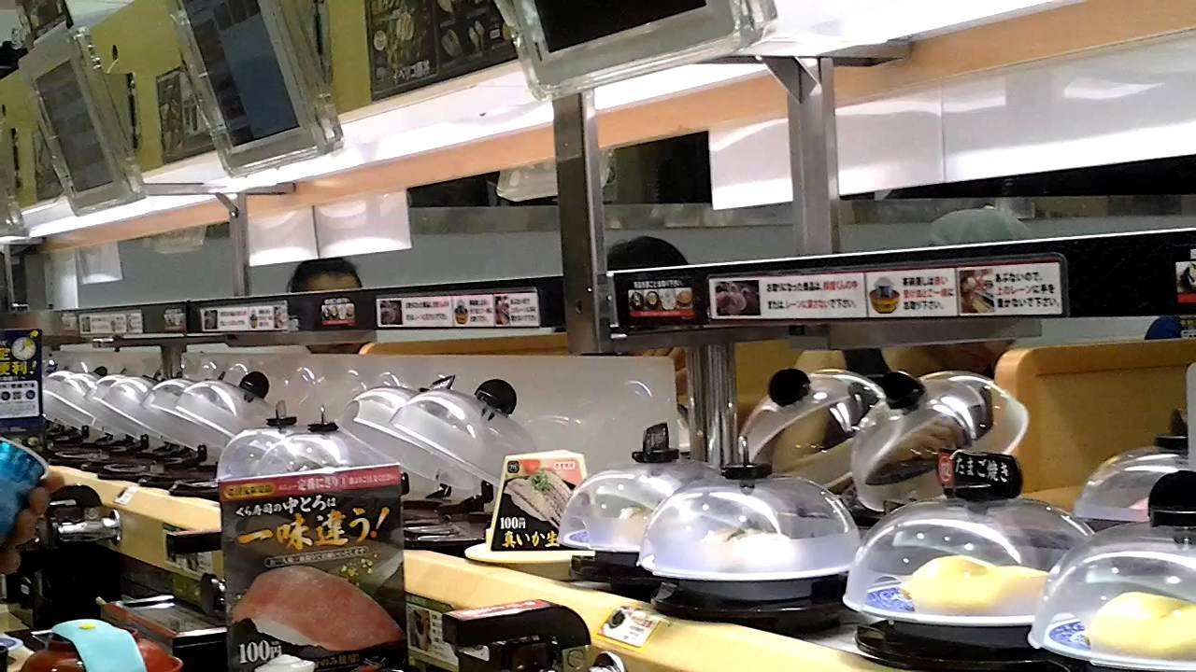
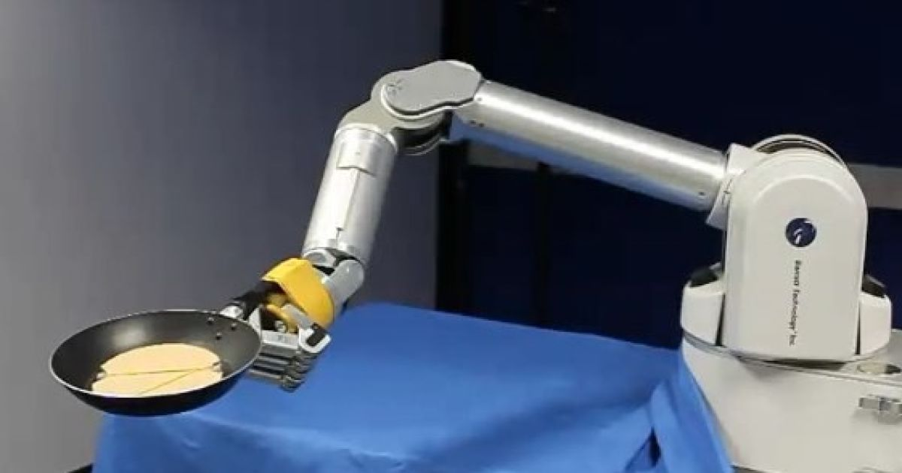
Project Plan - Market Survey
https://techcrunch.com/2018/06/21/creator-hamburger-robot/
https://uncrate.com/chefstack-automatic-pancake-machine/
https://www.engadget.com/2010/07/26/robot-arm-learns-to-flip-pancakes-can-never-know-the-joys-of-ta/
https://www.youtube.com/watch?v=R-xeNkPS4HM
Notes:
Top left: a burger startup that has been incredibly successful by automatically producing made to order burgers, but you can see that the design is very specialized. This machine will only ever be able to make burgers/
Top right: The current automated pancake machine design. This design isn’t used by restaurants, as both the speed and quality of the pancakes is inferior to those made by a worker.
Bottom left: A high end robotic arm that has been programmed to flip pancakes in a pan. This design is not meant to be commercial, and cannot cook the pancake by itself.
Bottom right: A japanese sushi chain that has successfully reduced the cost of many sushi dishes to under 1$ usd, by using automated systems for food preparation and serving. Our hope is that by creating a more adaptable device we can implement advanced automation systems like this in restaurants around the world.
From these examples we can see that there is a rapidly growing market for automated food preparation, however there aren’t any products on the market that apply efficient automation to pancakes, and there is currently no product on the market that is modular enough to be assigned a variety of food preparation tasks

Slide 5
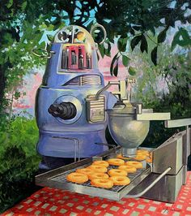
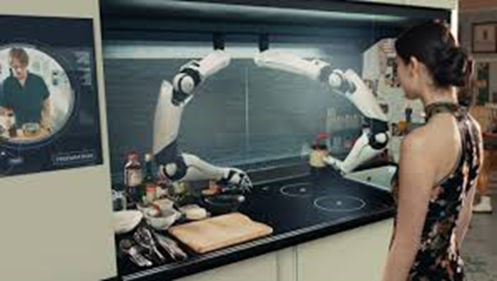
Functional Requirements
This machine will…
Efficiently, Automatically, and Uniformly make Pancakes
Perform With Safety in Mind For Both Users and Consumers
Have the Potential to Expand On and Change What it Can Produce
Operate in a Variety of Kitchen Environments (Modular)
http://www.moley.com/
https://www.coreyhelfordgallery.com/shows/ERIC-JOYNER-PURE-EVIL/COOKING-IN-A-FIELD/

Slide 6
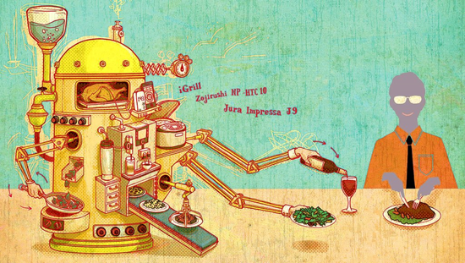
Non-Functional Requirements
This device should be…
Scalable
Low Maintenance
Reliable
Easy To Operate
Non-Intrusive
https://www.nytimes.com/2012/06/21/technology/personaltech/kitchen-technology-for-rice-coffee-and-cooking-thermometers-tool-kit.html

Slide 7
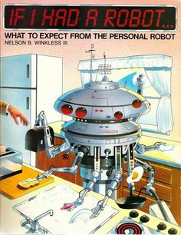
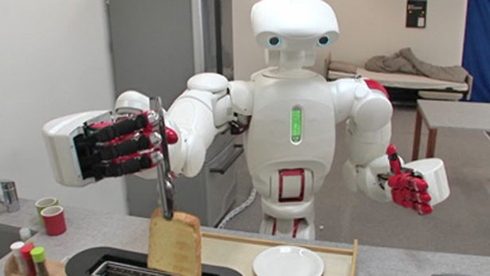
Technical/Other Constraints/Considerations
The team has considered…
Construction Material
Input/Output Communications
Open Source
Safety (Fire, Injury, Contamination)
IEEE Standards
https://newatlas.com/twendy-one-robot-elderly/14496/
https://paleofuture.gizmodo.com/if-i-had-a-robot-1984-512627080

Slide 8
Project Plan - Potential Risk & Mitigation
Potential Risk | Mitigation
Electric shock | Using proper electrical insulation and wiring management.
Malfunctions/Robotics safety | Using two kill-switches.
Fire | Choice of plastics (ABS plastic for heat-contact parts) as well as electrical safety.
3D printing failure | Paying careful attention to printing settings, and allocating resources to allow for additional printing.
Incompatible components | Carefully reviewing every component before purchase.
Notes:
We have a number of concerns for our project. A malfunctioning robot can cause serious damage to those around it, so we’ve ensured that two kill switches will be placed in easy to access locations to minimize any potential damage. We’ll be working in a high heat environment, so we’ve built our robot out of heat resistant materials to prevent fires and loss of function from heat.
3D printing failue is an important risk for our project completion. A large print can take days, and use up valuable material, as such we’ve allocated additional time and funds to reprinting any parts should the need arise.

Slide 9
Project Plan - Resources
Item | Projected Cost
3D printed parts | $65- 75
FPGA + accessories | $245 - 260
Camera + accessories | $180 - 190
Various extras: Small electrical components motors/fans Enclosure Printed circuit board and Arduino Bolts, wires, pulleys | $360 - 385
Total cost | $850-910
Notes:
Here is a brief layout of the the budgeted resources for our project.
Most notable is the 3D printing cost. When we first started our estimated 3D printing cost was between $300-600, but since then we have found alternative printing options that have allowed us to drastically cut costs.

Slide 10
Project Plan - Schedule

Slide 11
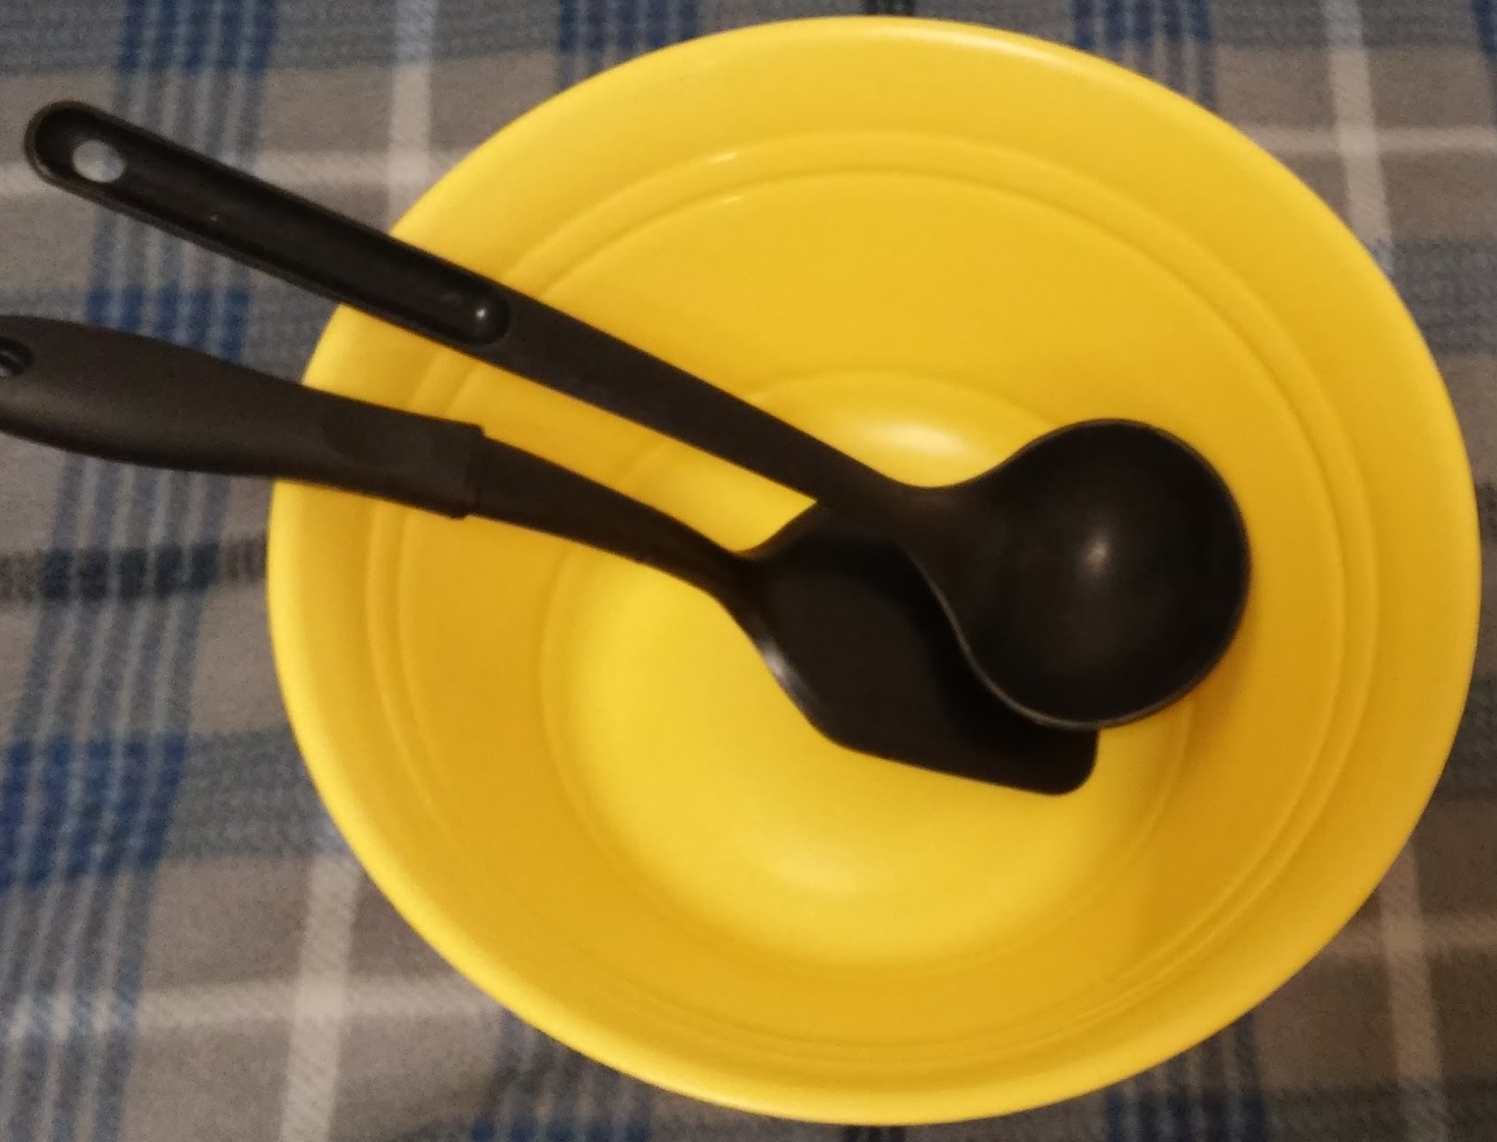
System Design - Functional Decomposition
High Level: Making Pancakes
1. Place batter on griddle
2. Cook until camera detects adequate bubbles
3. Flip the pancake
4. Cook for a predetermined amount of time
5. Remove pancake from griddle to plate
6. Repeat

Slide 12
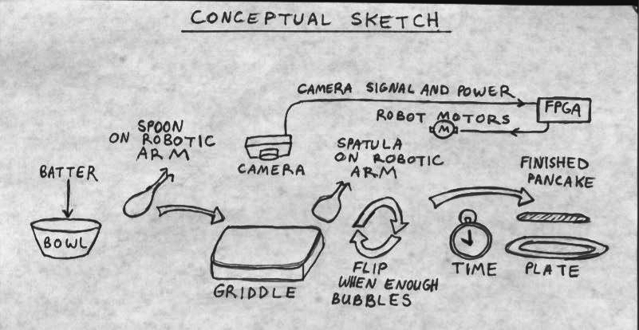
System Design - Functional Modules

Slide 13
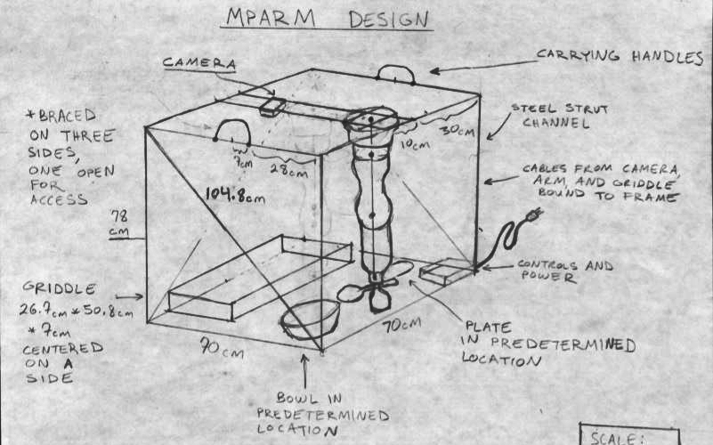
Detailed System Design

Slide 14
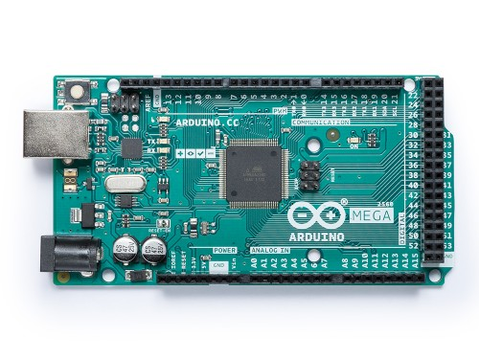
System Design - Hardware/ Software
Arduino Mega
Arduino Programming Language
https://store.arduino.cc/usa/arduino-mega-2560-rev3

Slide 15
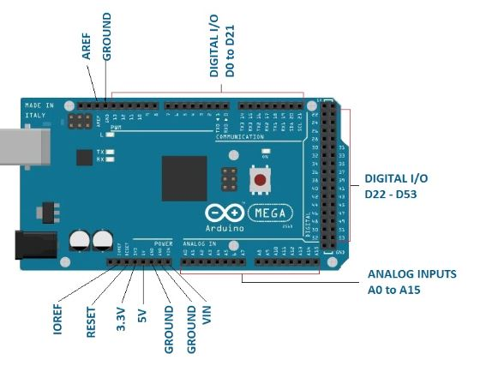
System Design - Arduino MEGA pinout
Source: http://www.circuitstoday.com/arduino-mega-pinout-schematics

Slide 16
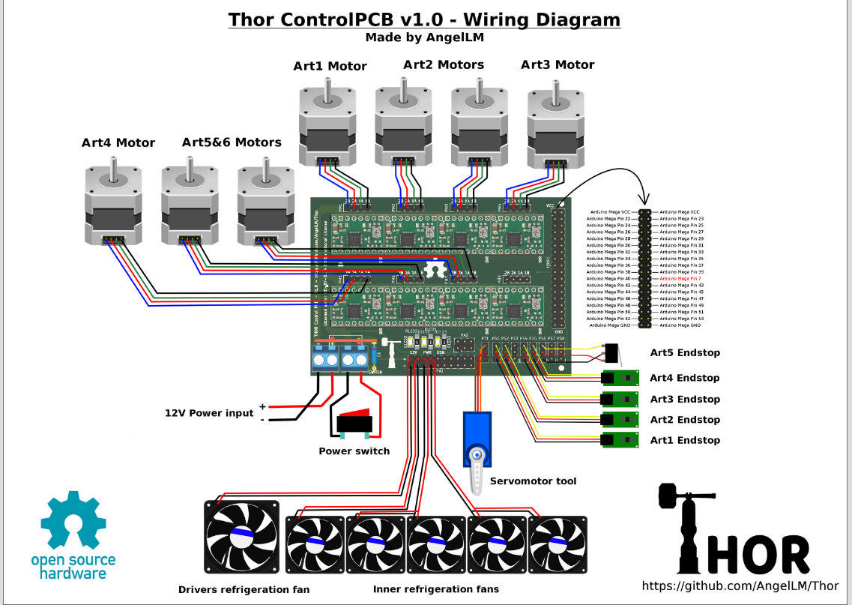
System Design - Motor Control PCB

Slide 17
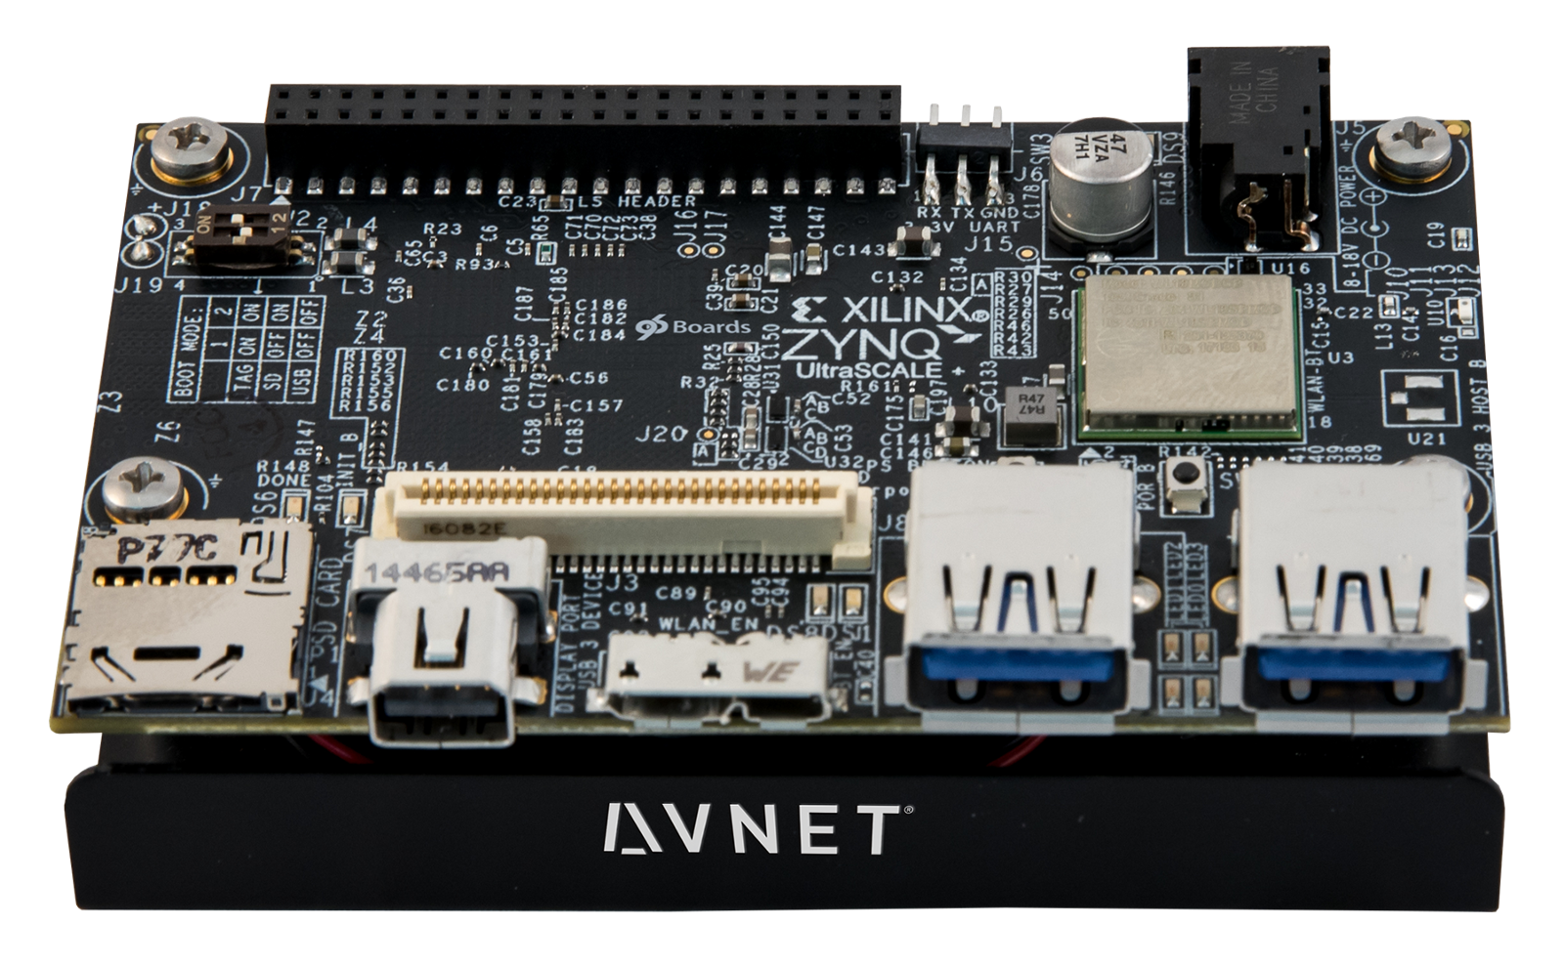
System Design - FPGA
Avnet Ultra96 FPGA
Hardware
Module pipeline setup
Programming
FPGA - C
Computer Vision Logic
Specs
USB downstream ports
https://blog.hackster.io/introducing-the-ultra96-zynq-ultrascale-development-board-e1ceeb4a1e9b

Slide 18
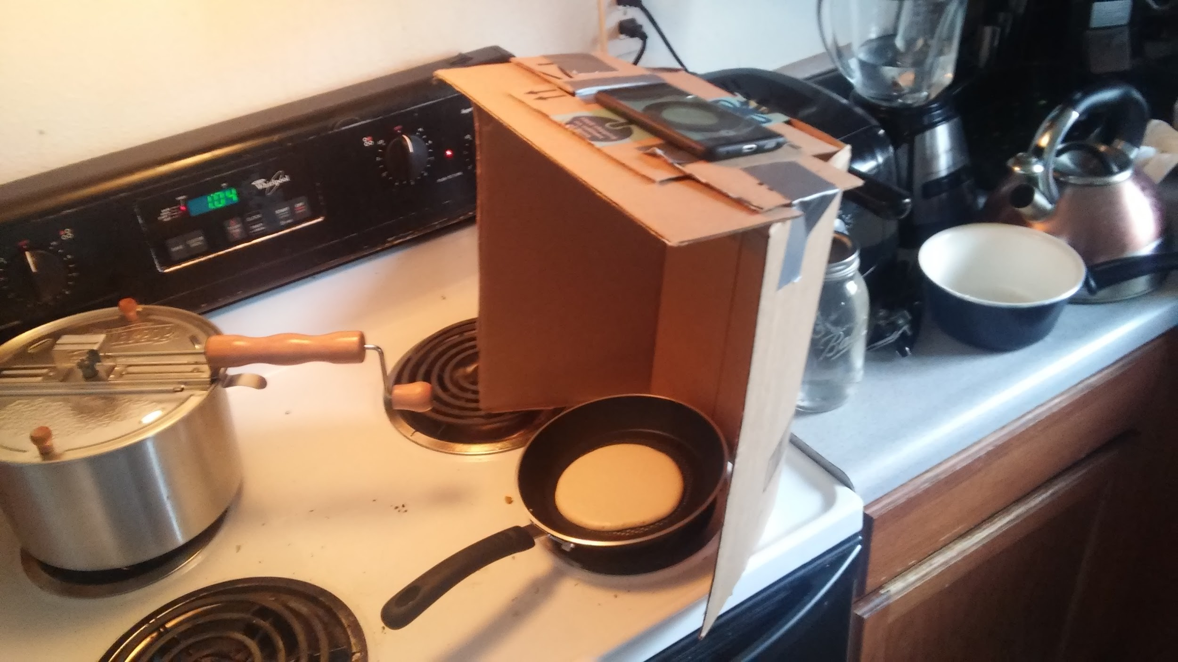
System Design - Test Plan
After testing we should be able to make a solid pancake.
Robotic Arm
Smoothness, Accuracy and Capability
Computer Vision
Speed and Accuracy
Electrical and Mechanical Systems
Circuitry, Voltage, Safety and Built Properly
Embedded Systems
Speed and Accuracy
Notes:
– Test Plan – simulation, what tests, what metrics, hypothesis, etc.

Slide 19
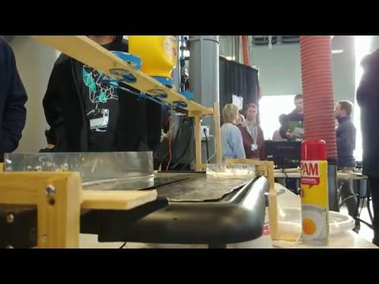
System Design - Prototyping
FlipJack
How
Arduino Controlled
Cooked on Sheet Metal
Servo Powered Flipping
Results
Cooked 3 pancakes every 10 minutes
10 minutes on each side
Pancakes were under-done
Pancakes stuck to the sheet metal

Slide 20
Conclusion - Milestone Status
Deliverables | % Done | Status
Project Proposal Accepted | 100% | The project was accepted
Demonstrate a Responsive User Interface | 25% | Decided on testing plan and final interface
The robotic arm is built | 60% | 60% of parts have been 3D printed
CV detects when a pancake is ready to flip | 40% | The CV program is in the debug process for video files
The robotic arm is programmed for cooking Pouring batter onto the flattop Flipping a pancake | 20% | The pancake recipe has been decided The technical flipping motion has been planned
The automated system can make pancakes | 25% | The subsystems are being developed

Slide 21
Conclusion - Team Members
Team Member | Responsibility | Semester Contributions
Brett Altena | Team Leader, Meeting Facilitator, and CV Developer | Programming CV Logic, Prototyping, and Team Liaison
Drew Caneff | Finance Manager and Electromechanical Engineer | 3D Printing Engineer and Accounting
Amos Hunter | Meeting Scribe and Electromechanical Specialist | Hardware Schematics, Power Supply, and Scribe Responsibility
Kristian Wadolowski | Report Manager and Front End Developer | Cooking Researcher and Editor
Jase Grant | Assignment Manager and Embedded Systems Engineer | FPGA Researcher and Module Design

Slide 22
Conclusion - Next Semester
Team Member | Plan for Next Semester
Brett Altena | Developing software for CV and mpARM control logic
Drew Caneff | Assembling the robotic arm and internal control system
Amos Hunter | Assembling the outer fixture, mounting the arm, connecting power supplies, and control circuits
Kristian Wadolowski | Programming the user interface and connectivity between Arduino program and FPGA signals
Jase Grant | Designing the connection between all modules through the FPGA

Slide 23
SDMAY19-31 mpARM
Questions?

