Slide 1
sdmay19-31
mpARM
(Multi-Purpose Automated Robotic arM)
http://sdmay19-31.sd.ece.iastate.edu/
Advisor: Prof. Alexander Stoytchev
Client: Brett Altena
Team: Brett Altena, Drew Caneff, Amos Hunter, Kristian Wadolowski, Jase Grant

Slide 2
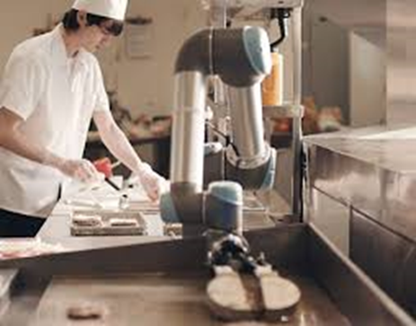
Problem Statement
Problem:
The Food Industry is Experiencing...
Increasing Production Cost of Food
Product Inconsistency
High Food Preparation Times
Kitchen Related Injuries
Solution:
An Automation System That Can…
Function in an Already Existing Kitchen Environment
Work Alongside Humans in the Workplace
Prepare a Variety of Menu Options
Utilize Computer Vision (CV) Coupled With a Robotic Arm For Food Preparation
Goal is to have our system perform the tasks of a human chef at maximum efficiencies
https://www.asme.org/engineering-topics/articles/robotics/robots-kitchen-at-the-table

Slide 3
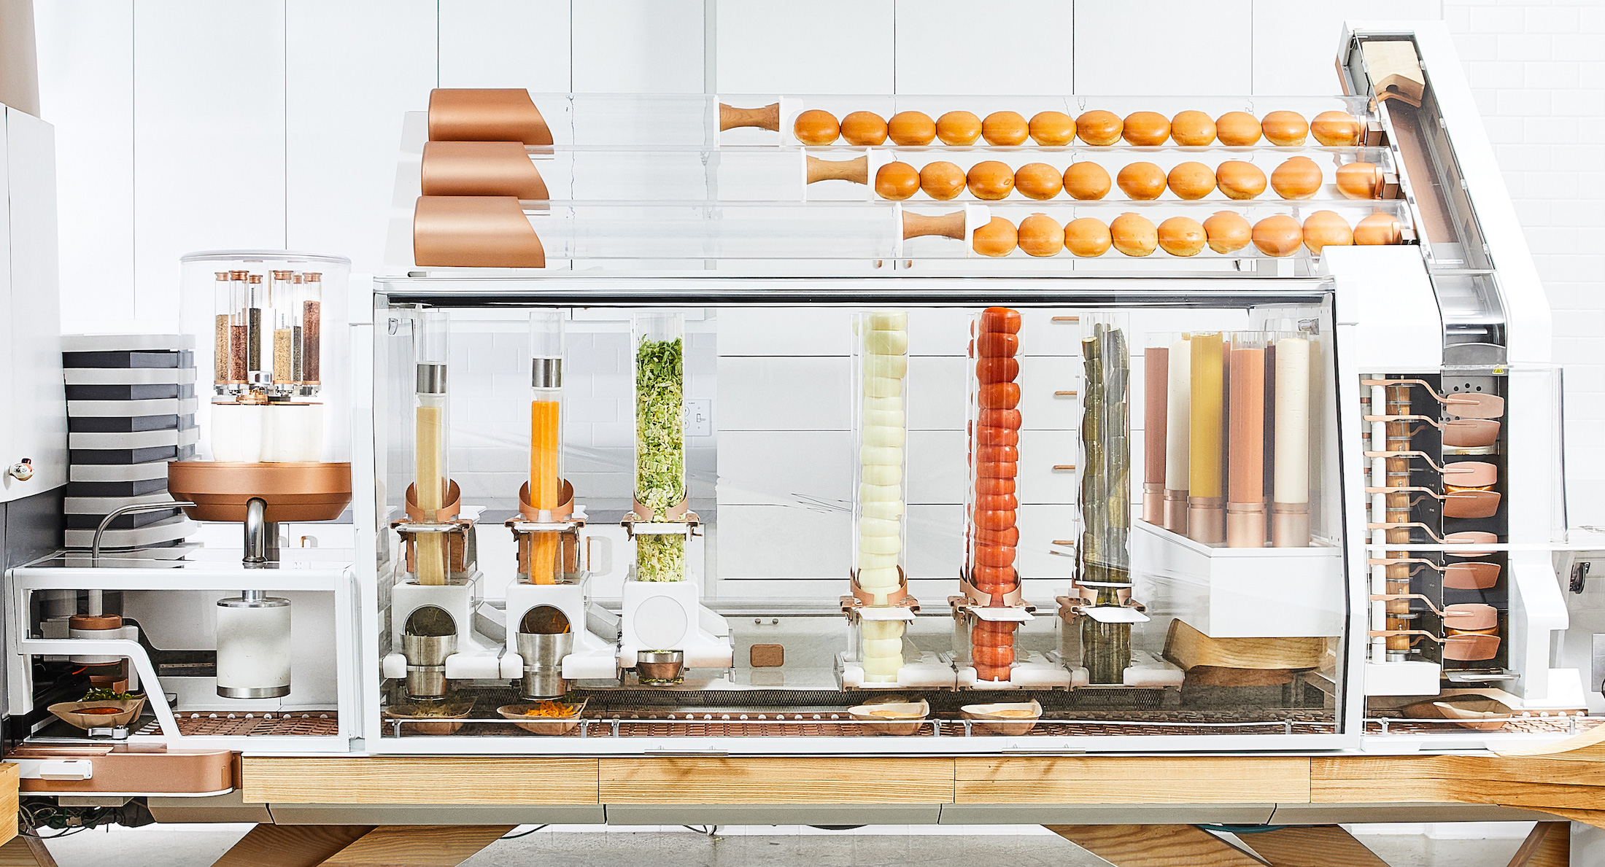
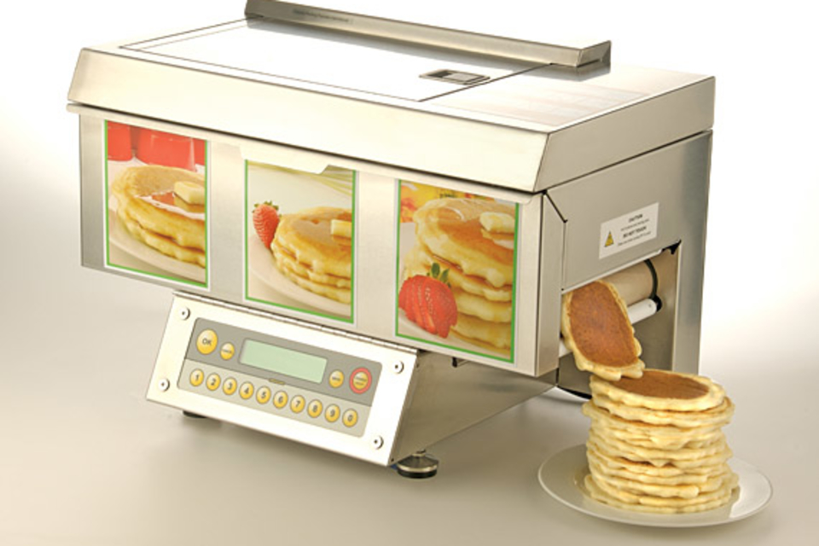
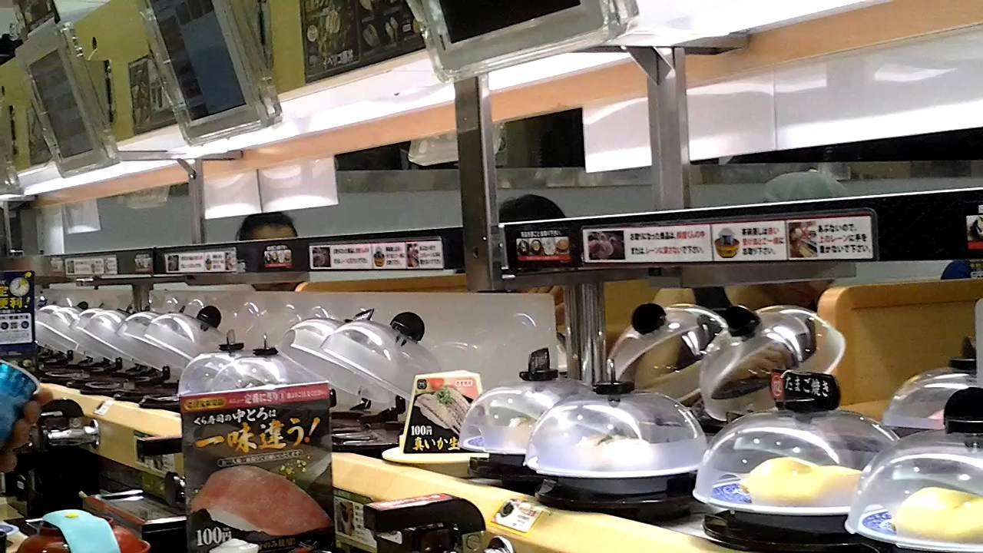
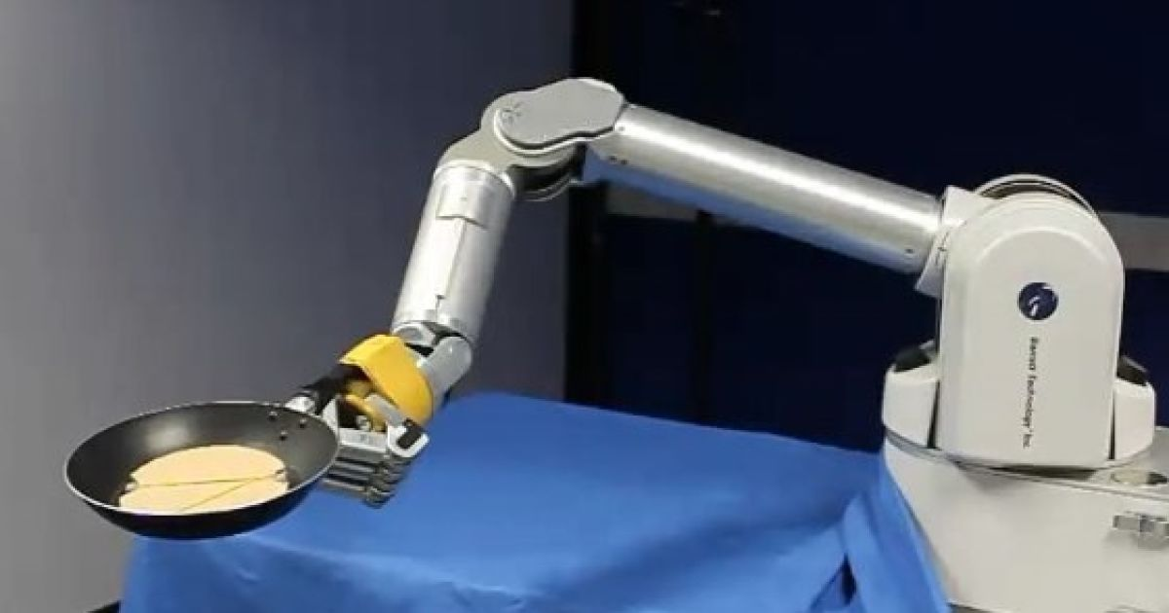
Market Survey
https://techcrunch.com/2018/06/21/creator-hamburger-robot/
https://uncrate.com/chefstack-automatic-pancake-machine/
https://www.engadget.com/2010/07/26/robot-arm-learns-to-flip-pancakes-can-never-know-the-joys-of-ta/
https://www.youtube.com/watch?v=R-xeNkPS4HM
Notes:
Top left: a burger startup that has been incredibly successful by automatically producing made to order burgers, but you can see that the design is very specialized. This machine will only ever be able to make burgers/
Top right: The current automated pancake machine design. This design isn’t used by restaurants, as both the speed and quality of the pancakes is inferior to those made by a worker.
Bottom left: A high end robotic arm that has been programmed to flip pancakes in a pan. This design is not meant to be commercial, and cannot cook the pancake by itself.
Bottom right: A japanese sushi chain that has successfully reduced the cost of many sushi dishes to under 1$ usd, by using automated systems for food preparation and serving. Our hope is that by creating a more adaptable device we can implement advanced automation systems like this in restaurants around the world.
From these examples we can see that there is a rapidly growing market for automated food preparation, however there aren’t any products on the market that apply efficient automation to pancakes, and there is currently no product on the market that is modular enough to be assigned a variety of food preparation tasks

Slide 4
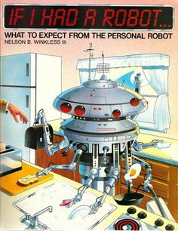
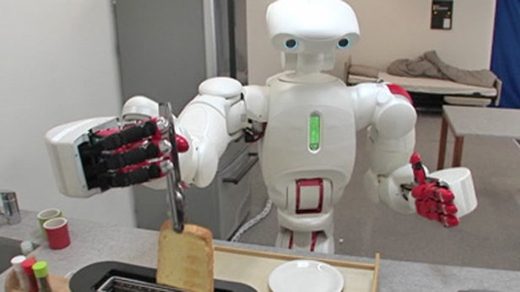
Technical/Other Constraints/Considerations
The team has considered…
Construction Material
Input/Output Communications
Open Source
Safety (Fire, Injury, Contamination)
IEEE Standards
https://newatlas.com/twendy-one-robot-elderly/14496/
https://paleofuture.gizmodo.com/if-i-had-a-robot-1984-512627080

Slide 5
Project Plan - Potential Risk & Mitigation
Potential Risk | Mitigation
Electric shock | Using proper electrical insulation and wiring management.
Malfunctions/Robotics safety | Using two kill-switches.
Fire | Choice of plastics (ABS plastic for heat-contact parts) as well as electrical safety.
3D printing failure | Paying careful attention to printing settings, and allocating resources to allow for additional printing.
Incompatible components | Carefully reviewing every component before purchase.
Notes:
We have a number of concerns for our project. A malfunctioning robot can cause serious damage to those around it, so we’ve ensured that two kill switches will be placed in easy to access locations to minimize any potential damage. We’ll be working in a high heat environment, so we’ve built our robot out of heat resistant materials to prevent fires and loss of function from heat.
3D printing failue is an important risk for our project completion. A large print can take days, and use up valuable material, as such we’ve allocated additional time and funds to reprinting any parts should the need arise.

Slide 6
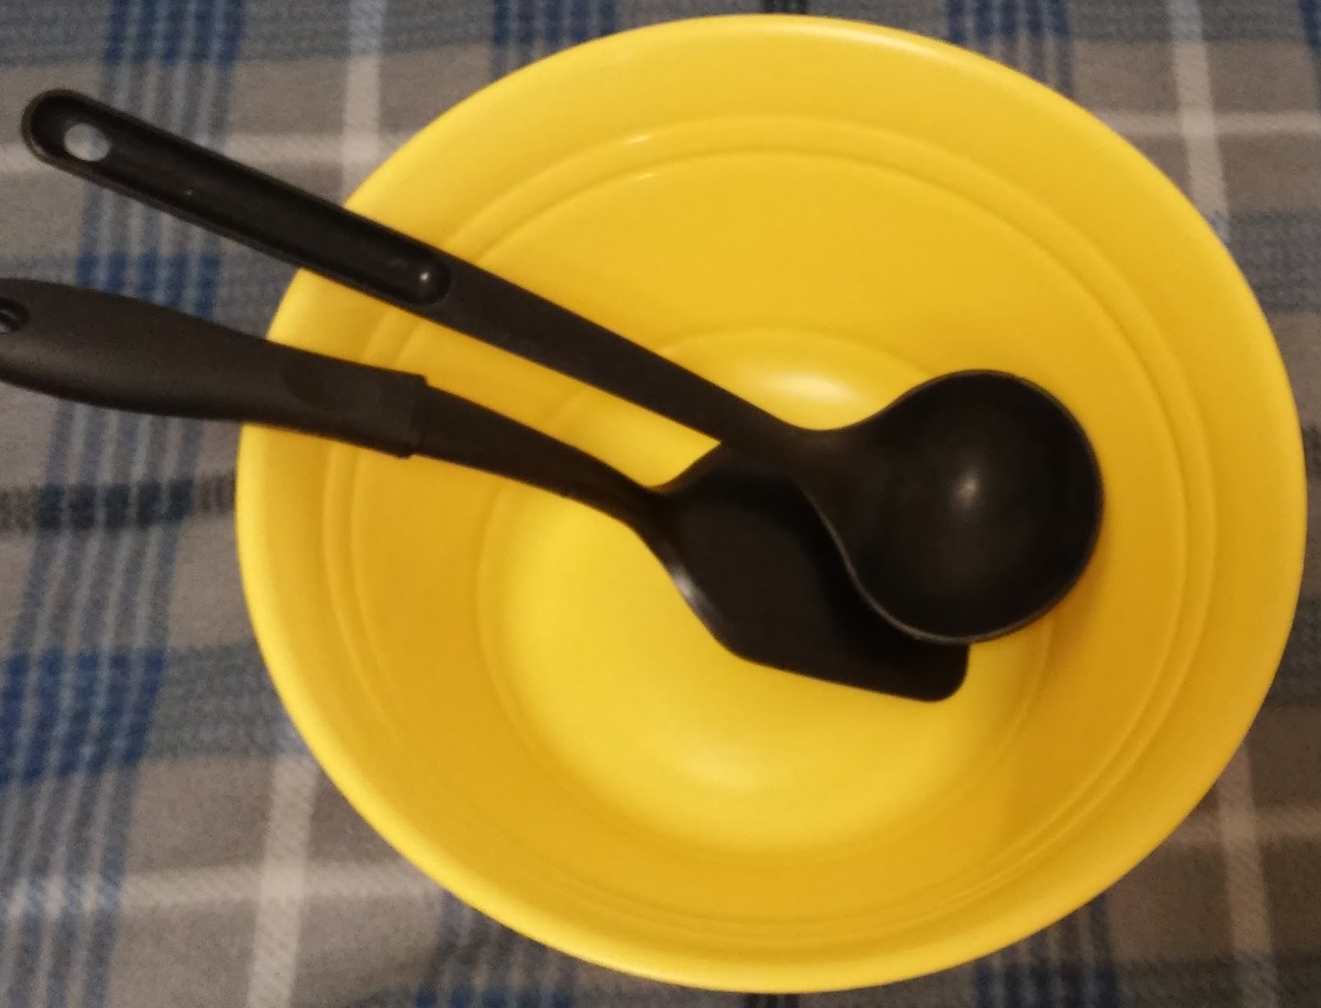
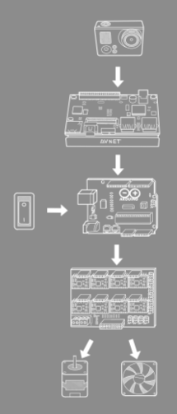
System Design - Functional Decomposition
High Level: Making Pancakes
1. Place batter on griddle
2. Cook until camera detects adequate bubbles
3. Flip the pancake
4. Cook for a predetermined amount of time
5. Remove pancake from griddle to plate
6. Repeat

Slide 7
Programming Requirements
Functional Requirements:
A computer vision program
Can be ran multiple ways
Real-time bubble detection
Outputs serial output
An Arduino program
Receive serial input and output electrical signals
Non-Functional Requirements:
The robot to move smoothly
Accurately pick up the pancake by seeking its center
A smooth transition between motions
A resting position that the arm returns to after completing its task.

Slide 8
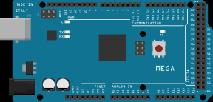
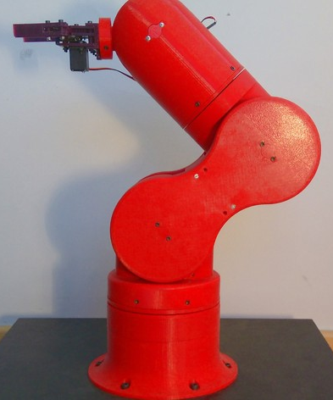
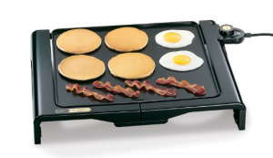
Programming Design
Ideal Environment
Constant Pancake Size
Constant Lighting
Set Camera Distance
Perpendicular Camera Angle
High Camera Definition

Slide 9
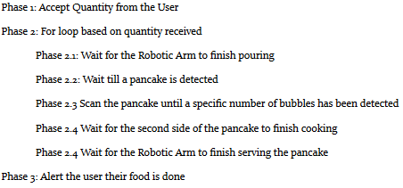
Programming Implementation
Algorithms
Hough Circles
Background Subtraction/ Contour Detection
PWM Signals
Dataflow
User Interaction
Command Line Execution
User Friendly Execution
Demo Buttons

Slide 10
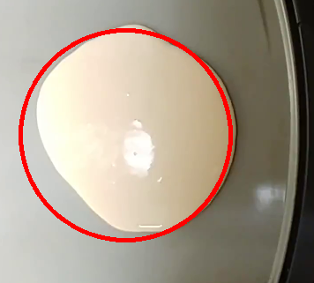
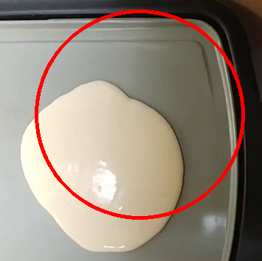
Computer Vision Testing
Pancake Detection
Accurate
Pancake Detection
Inaccurate

Slide 11
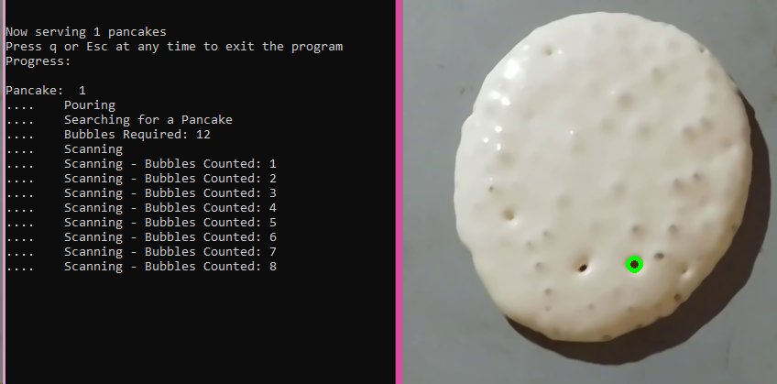
Computer Vision Testing
Hough Circles

Slide 12
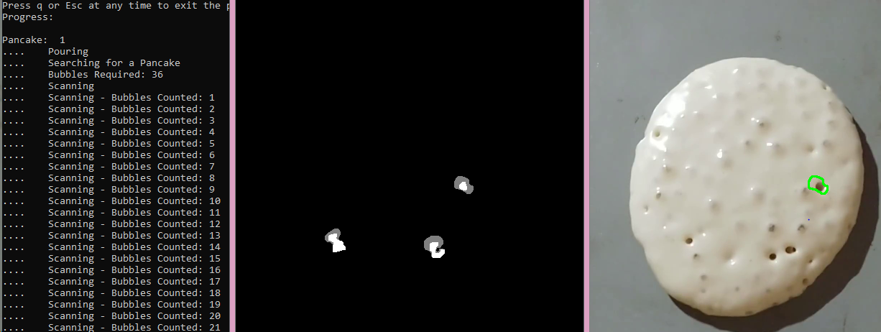
Computer Vision Testing
Background Subtraction/ Contour Detection

Slide 13
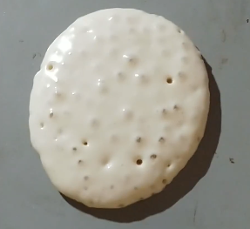
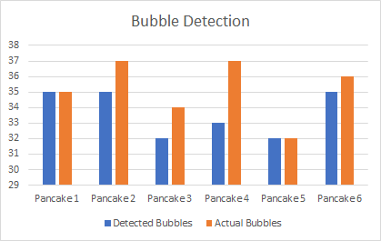
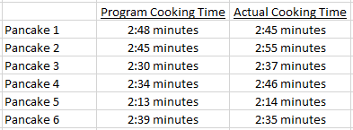
Programming Evaluation
Experiment 1
Success:
100%

Slide 14
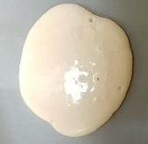
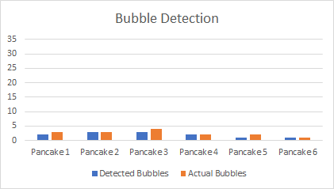
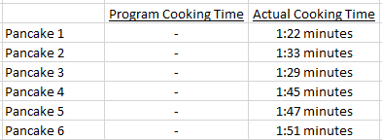
Programming Evaluation
Experiment 2
Success:
0%

Slide 15
FPGA Requirements
Functional Requirements:
Needs to run the Python code on the FPGA.
Needs to take in a camera image.
Needs to be able to output to the arduino.
Commands given via command line.
Kill-Switch.
Non-Functional Requirements:
Running a bitstream to speed up the Computer Vision.
Commands given via buttons.

Slide 16
FPGA Design
FPGA OS:
The OS running on the FPGA is PYNQ.
FPGA Programing:
PYNQ runs Python code formatted in a Jupyter Notebook..
PYNQ allows for overlays to be implemented.
FPGA Hardware Acceleration:
Vivado is use to make a pipeline overlay for the FPGA hardware components.
Vivado compiles it into a bitstream
Notes:
What is great about the ultra96 are the many way to connect to it.

Slide 17
FPGA Implementation
FPGA OS:
Installed by installing a PYNQ with PetaLinux image file on a SD card then booting the FPGA.
FPGA Programming:
The Computer Vision code need to be segmented to run in parts because of the Jupyter format.
The Python code needs to be changed to import the overlay.
FPGA Hardware:
The pipeline is set up by connecting ip cores.
Then a bitstream is imported into PYNQ.
Notes:
Lib is xfopencv

Slide 18
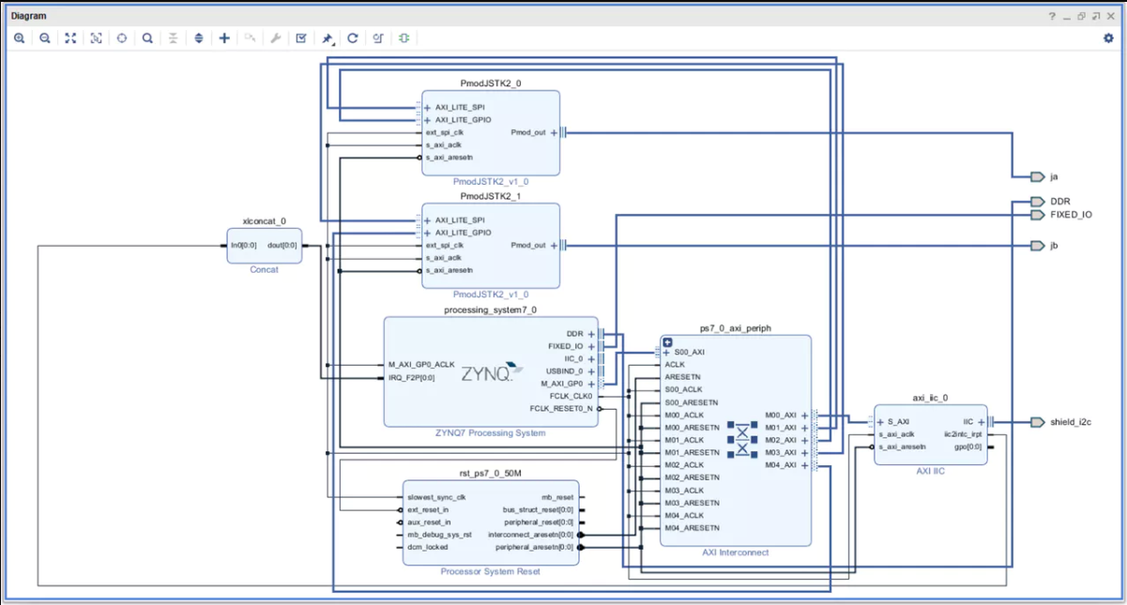
FPGA: Pipeline + Importing overlay

Slide 19
FPGA Testing and Evaluation
FPGA Programing Testing:
Jupyter Notebooks are segmented and can be easily tested.
FPGA Hardware Testing:
Vivado runs simple tests on the pipeline while generating the bitstream.
Other testing of the overlay is hard until the end.
The frames per second executed can be measured for both software and hardware.

Slide 20
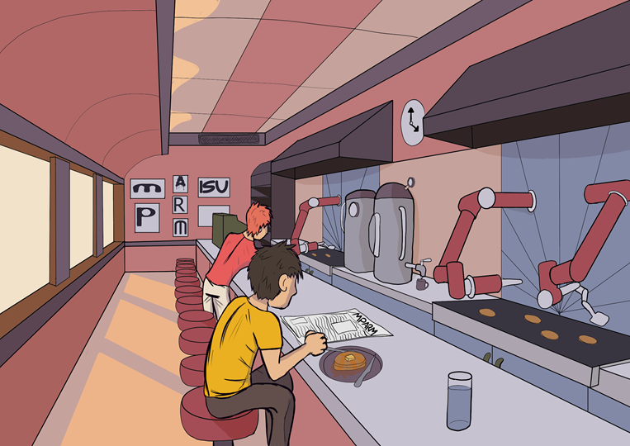
Electromechanical Requirements
Functional:
Safe to Operate
Repeatable Motions
Replicate Human Motion
Heat Resilient
High Payload Capabilities
Non-Functional:
Low Cost
Reliable
Low-Maintenance
Space Efficient
Intuitively Operated

Slide 21
Electromechanical Prototyping
Implementation
Arduino Controlled
Cooked on Sheet Metal
Servo Powered Flipping
Results
Cooked 3 pancakes every 10 minutes
10 minutes on each side
Pancakes were under-done
Pancakes stuck to the sheet metal

Slide 22
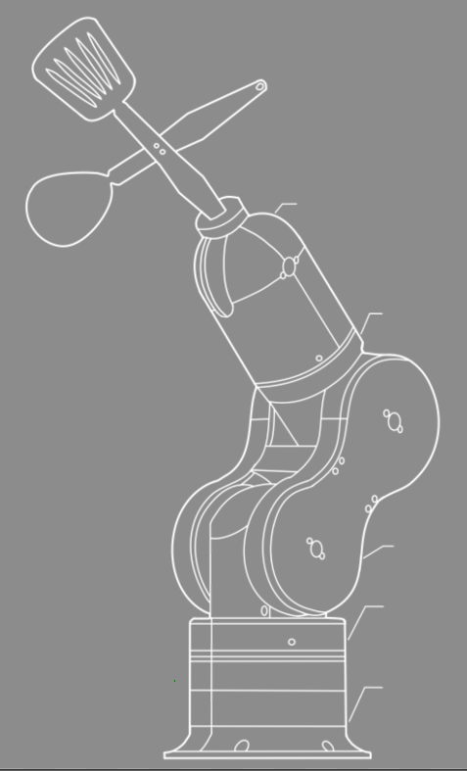
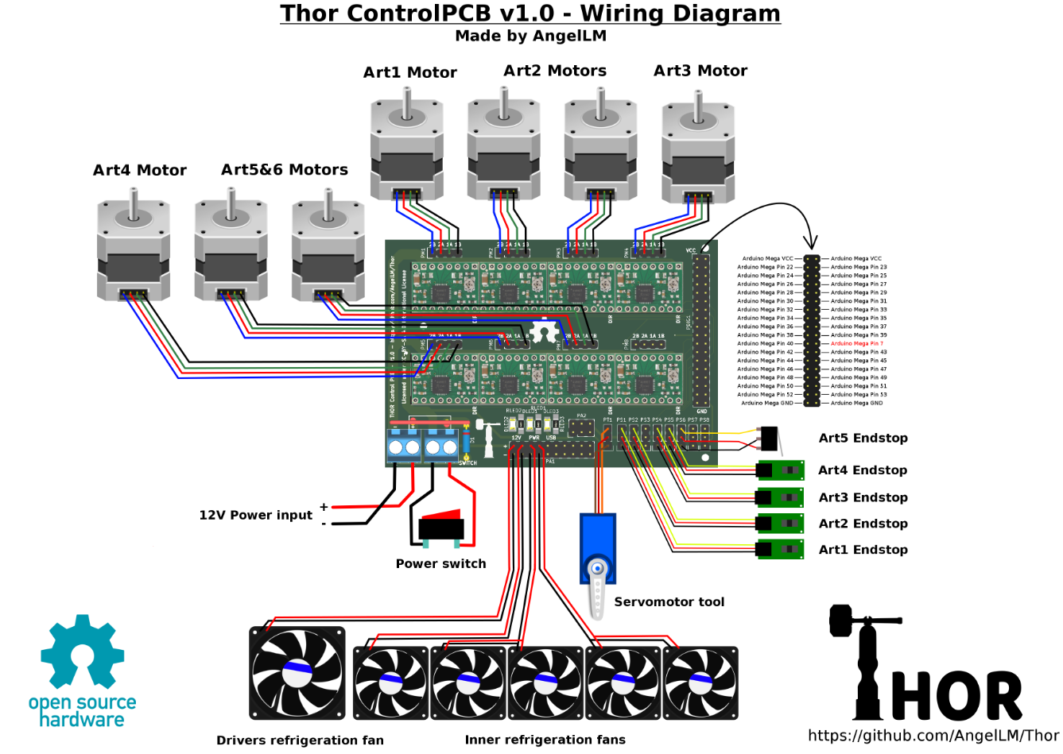
Electromechanical Design
Mechanical:
Robotic Arm
3D Printed
Open Source
Self Contained System
Electrical:
Includes: Camera, FPGA, Arduino, Power Distribution PCB, Robot Motors, User Interface
Low Cost
Open Source

Slide 23
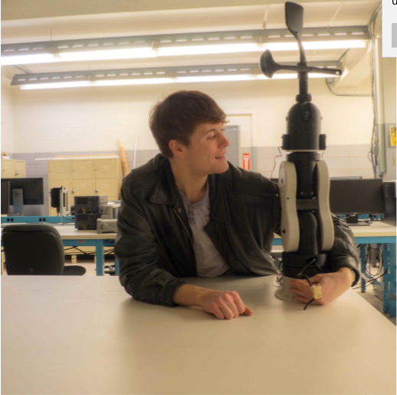
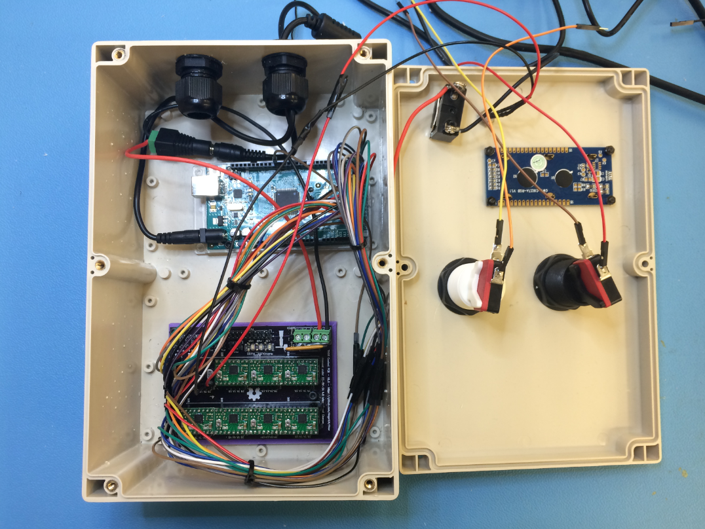
Electromechanical Implementation
Evaluated Open Source Robotic Arms
3D Printed Robotic Arm Components
Constructed Power Distribution PCB
Assembled Robotic Arm Articulations Separately
Combined all Robotic Arm Components
3D Modeled Custom Parts
Integrated Essential Circuit Components
Debugged Electrical System
Created Final Electrical Subsystem Complete with User Interface
Started Testing and Fixing Mechanical System
Started Implementing the Final Circuit System with the Robotic Arm

Slide 24
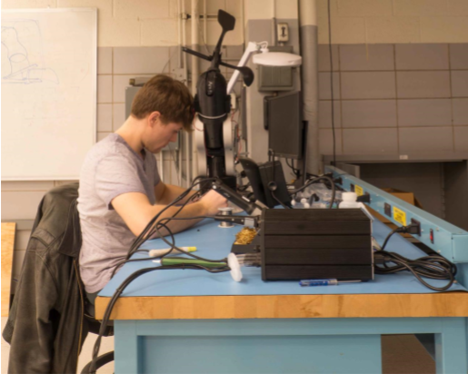
Electromechanical Testing and Evaluation
Electrical:
Observed Electrical Signals Using Oscilloscope and Multimeter
Followed Signals Starting From Arduino to Motor Outputs
Verified Code can Send Signal Through Entire Electrical System to Any Output
Mechanical:
Tested Articulations Individually Utilizing a Confirmed Working Code and Electrical System
Verifying Each Articulation Can Fully Rotate and Return to Original Position

Slide 25
Frame and Base - Requirements
The project needed
a sturdy frame to mount the camera
safety
cleanliness
a solid base to mount the arm
aesthetics
Outlined in out project plan and design document
requirements changed over time
necessitated communication with the rest of the team throughout both semesters

Slide 26
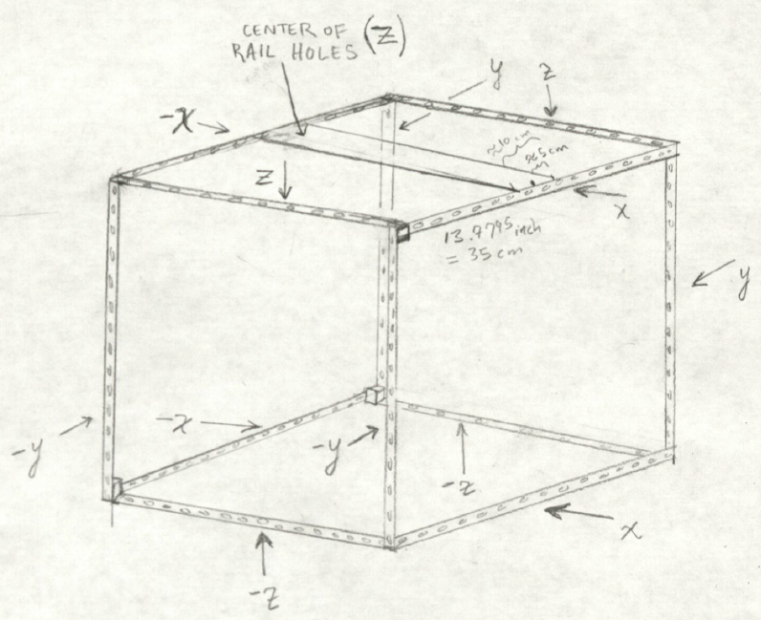
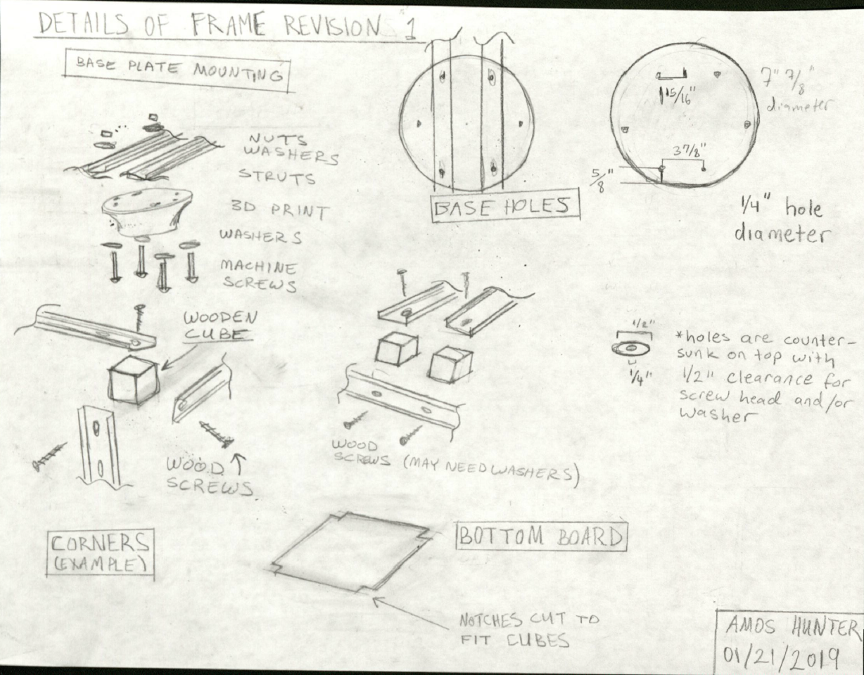
Frame and Base - Design
fit requirements but continued to change

Slide 27
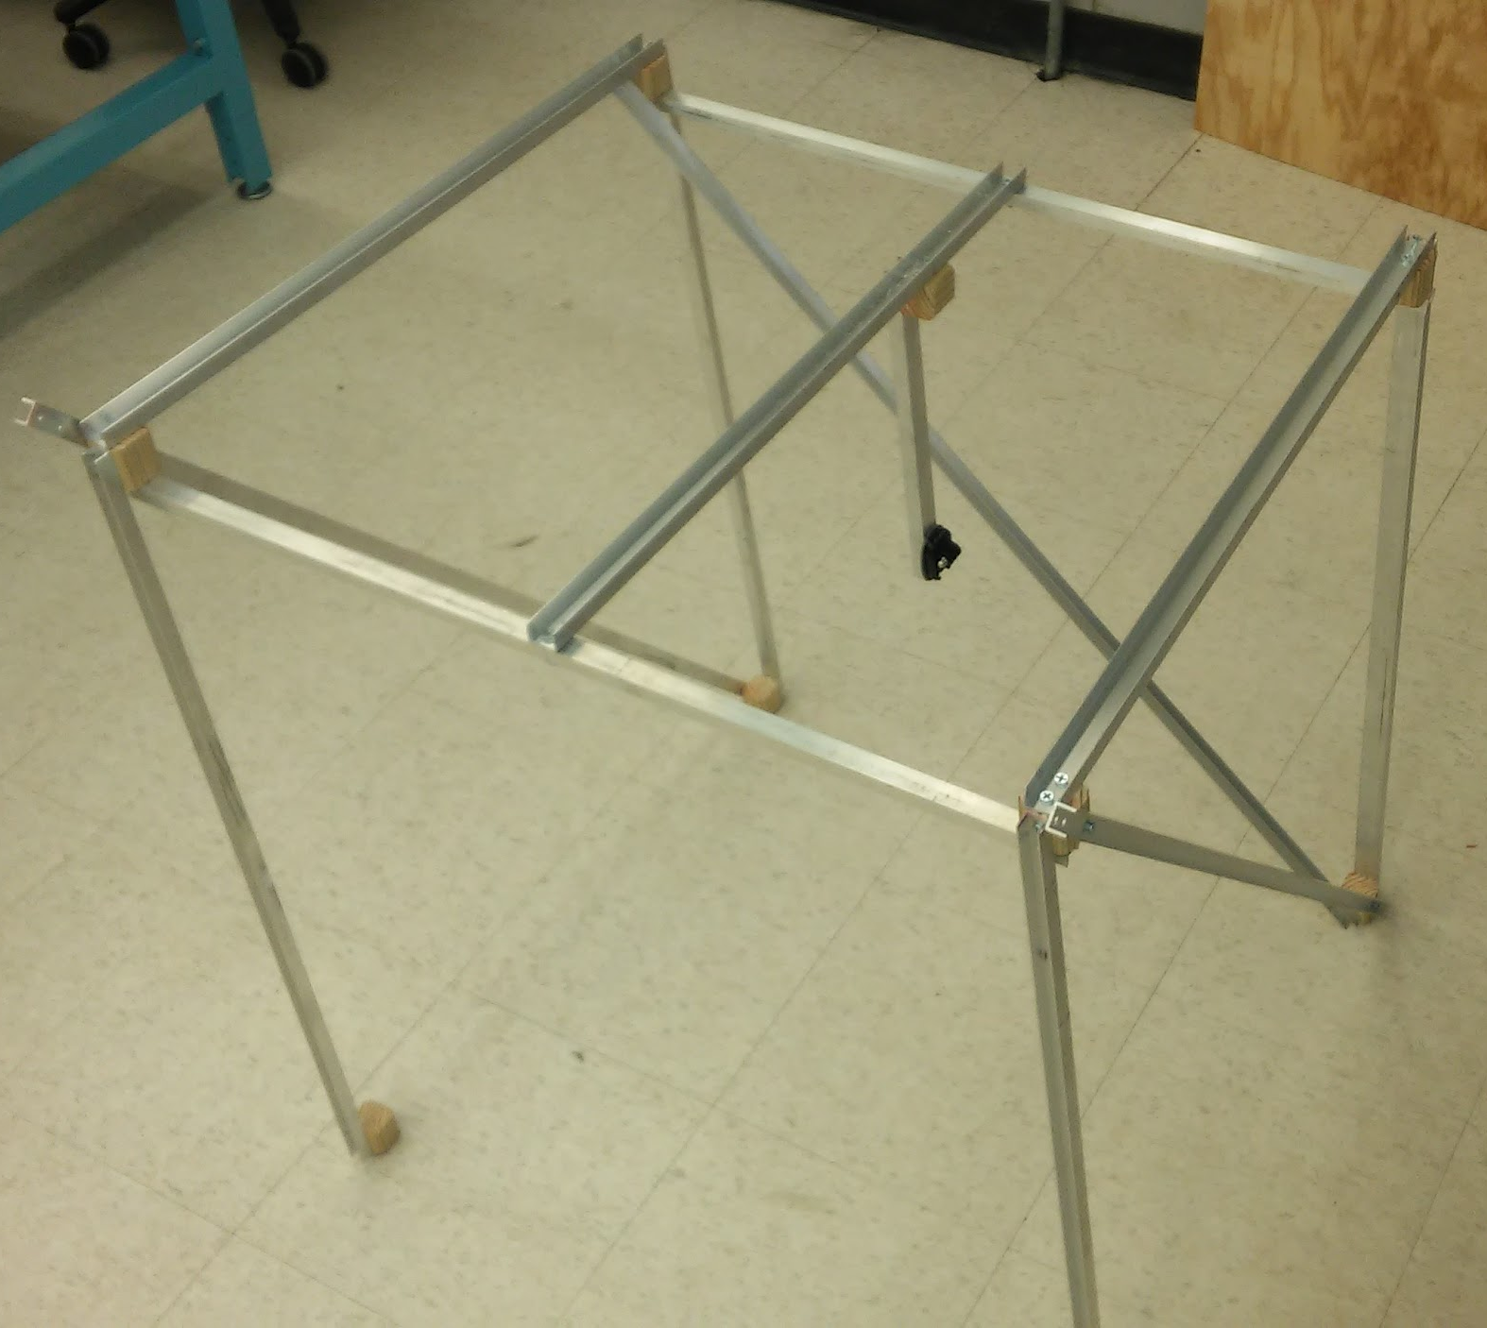
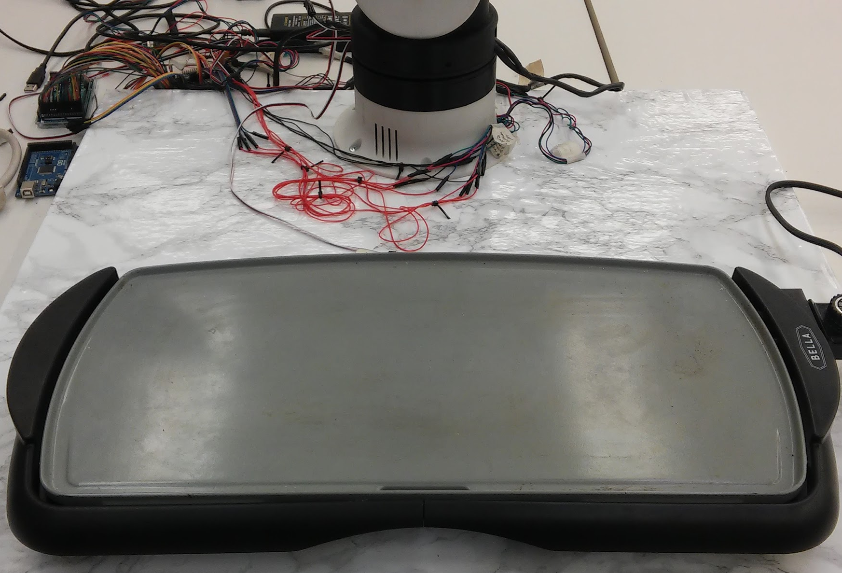
Frame and Base - Implementation
Purchasing materials, assembly and building, systems integration (most challenges)

Slide 28
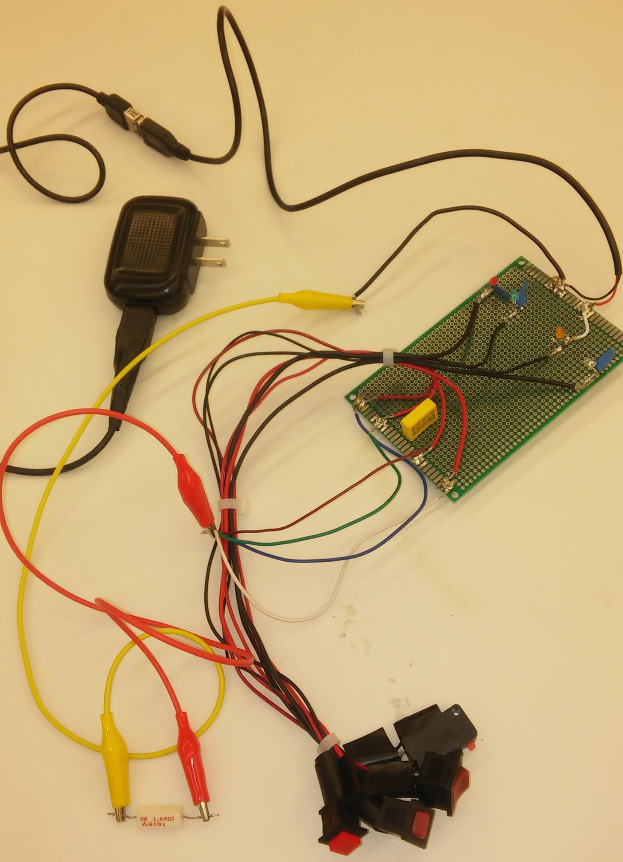
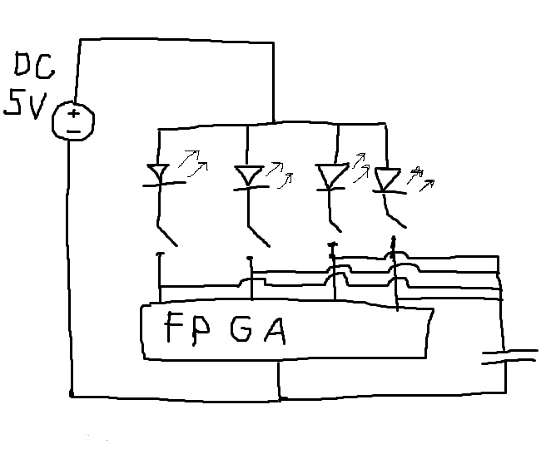
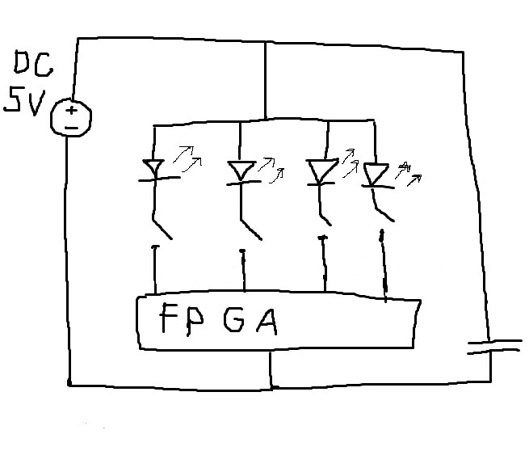
Frame and Base - Testing and Evaluation
An FPGA tester
Making sure the frame was strong enough
Evaluating arm placement made changes for the base

Slide 29
Conclusion
Summary
Good learning experience and exercise in utilizing engineering skills
Incomplete, but a lot of progress was made in the time had
Future Work
Focus more on perfecting the environment
Use a thermal image camera to read internal temperature
Further work on the Arduino Code

Slide 30
SDMAY19-31 mpARM
Questions?

